Slide 1
Thermal Cameras and ASOS
By Anmol Dash

Slide 2
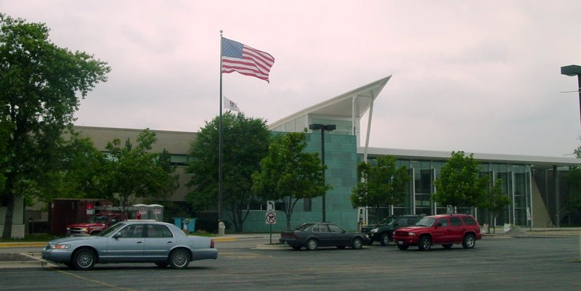
Who am I?
Rising senior at Adlai E. Stevenson High School
I am active in my school’s Debate, Biology Olympiad, Scholastic Bowl, History Bowl/ Academic team, and a couple others
I love working with computers(though sometimes they don’t like working with me)
In my free time I like playing video games(COD) and playing basketball
This is my first summer here
I’ve been to Argonne three times already
I also play 4 different instruments and sound terrible on all of them.

Slide 3
Big Questions
How does calculated LCL and CCL verify with observed thermal bases from thermal cameras?
Are there any patterns we can observe from ASOS station data and/or thermal image data?
Can we use any of this data to observe future trends and make weather predictions at the site?

Slide 4
Tools
MOBOTIX System
Thermal imaging system. Gives array of temperatures, the actual images from the site, as well as a combination of both of them.
FLIR Camera
Another thermal imaging system.
ASOS
Series of observation stations across the country(even at O’Hare!) with data going back to 1901. Measures a variety of weather features(precipitation, wind direction and speed, snow depth, average temperature, maximum temperature, minimum temperatures
Machine learning!

Slide 5
Limitations
The MOBOTIX pictures are nice, but are meant to highlight contrast, not necessarily the actual temperatures
The FLIR camera( as far as I can tell) does not have an equivalent actual camera to show the difference
The ASOS stations do not necessarily all have data going to back to 1901 and with all the data mentioned previously
What machine learning can we use? Will it work?

Slide 6
What are LCL and CCL?
LCL(Lifting Condensation Level)
Requires lifting of the air parcel
Height at which the relative humidity of an air parcel reaches 100%.
Can be used to estimate the height of a cloud base
CCL(Convective Condensation Level)
Similar to LCL, though must reach critical convective temperature
Usually equal to LCL, or slightly higher

Slide 7

Which machine learning technologies can we use?
Deep Neural Network
LightGBM

Slide 8
What are they?

Slide 9
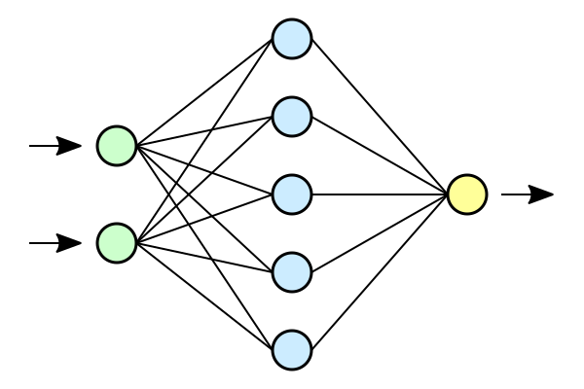
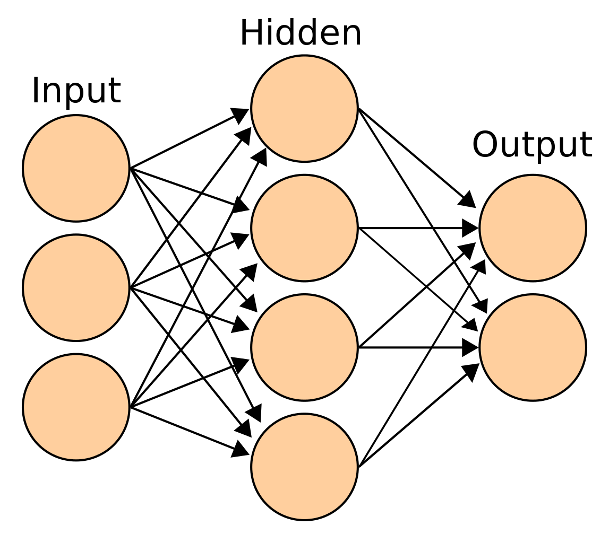
Deep Neural Network
Neural Network with at least two layers
Will likely use Pytorch
Can eliminate the need for thorough feature engineering(helpful for ASOS data, which has dozens of variables)
Can utilize unstructured data
Evaluation of Machine Learning Classifiers for Predicting Deep Convection(Ulkonnen et al.)

Slide 10
LightGBM
Is a Gradient Boosting Model(Gives more emphasis on wrongly/undertrained samples in later learners)
Uses a histogram-based decision tree model(faster than a sklearn decision tree)
Two key features is GOSS and EFB
GOSS(Gradient Based One Side Sampling) keeps instances with small gradients(normally presumed to already been trained) to more evenly represent distribution.
EFB(Exclusive Feature Bundling) bundles features together to reduce training complexity.
Long-term rainfall forecast model based on the TabNet and LightGbm algorithm
(Yan et al.)

Slide 11
Differences
DNN is a neural network, and LightGBM is not.
Deep learning takes more time(though less effort in feature engineering) and is more useful in cases where the sources for data differ.
In this case, they really don’t.
Interpretability is a problem for the deep neural network.
Light GBM is easier to understand
Easier to run at home(my access to the Argonne computers is limited)
Light GBM also easier to “repair” if things go wrong

Slide 12
Nice to Haves
Is there anything else we can derive from the ASOS data?
Where is the best place to point the thermal cameras?
What other factors seem to correlate the most/have the greatest effect on each other?
Are there any other uses for the thermal cameras?
Can we use the thermal images in other ways? Are they actually useful?

Slide 13

Personal Goals
Make connections and meet new people
Gain research experience
See how past experiences with machine learning can be applied to actual research
Explore different areas of potential interest/research
Have a functional project at the end

Slide 14
What I’ve done
Worked with getting used to different features of the ASOS data and how to interpret the thermal image data
Experimented with classifying different ASOS data based on seasons
Working on seeing how best to implement the two ML models and how exactly to go about doing that.

